Slide 1
Music and memory

Slide 2
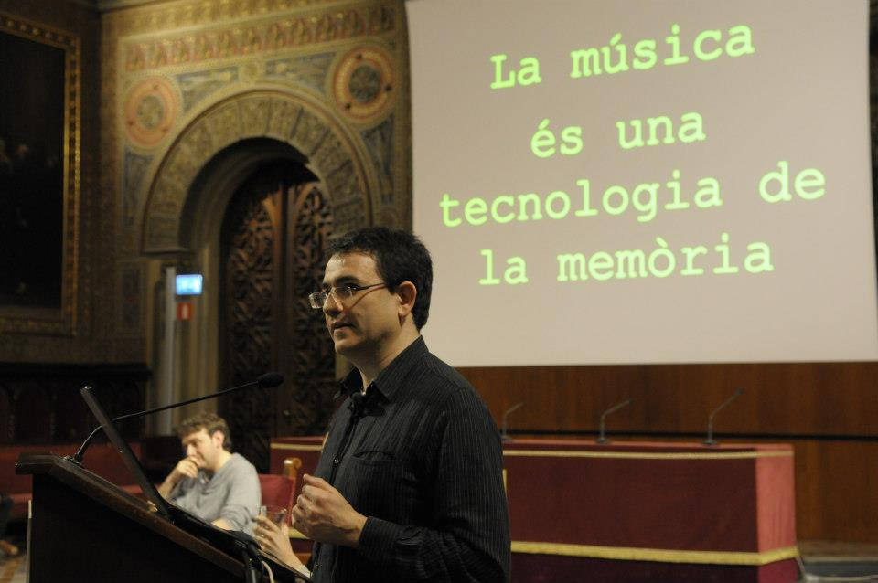
Music is a technology of memory

Slide 3
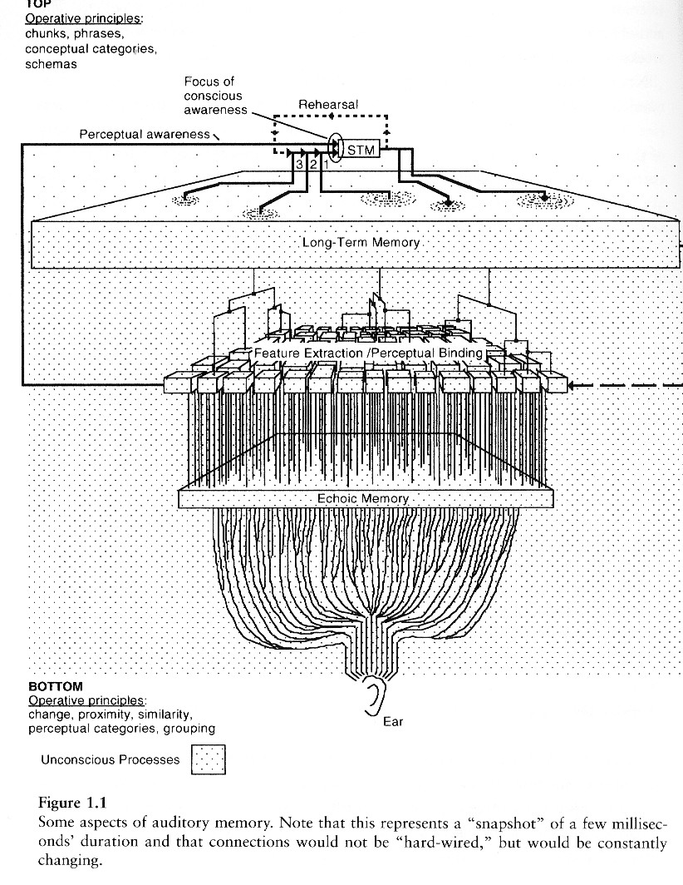
Memories
Top-down (knowledge based) influences

Slide 4
Recognition of familiar melodies
Can we identify a musical piece just using one note? (the radio dial scanning effect: how much info can be extracted from 250ms?)
We are going to progressively reveal more notes (5 seconds’ silence in-between). Raise the hand when you recognise the piece.

Slide 5
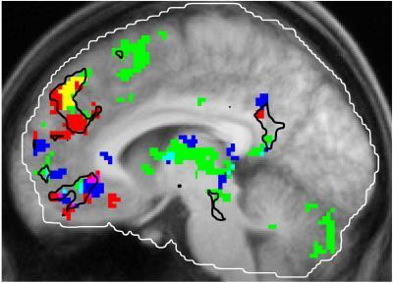
Simultaneous activation of different “memories” when listening to music
Green areas are activated by familiar tunes
Red areas respond to salient autobiographical memories,
Blue areas respond to tunes that a person enjoys
Memories are distributed across our cortex: some traces in auditory cortex, some in visual cortex, some in motor cortex, some in frontal cortex…
Petr Janata, The Neural Architecture of Music-Evoked Autobiographical Memories, Cerebral Cortex, 2009

Slide 6
"It was not only difficult for him to understand that the generic term dog embraced so many unlike specimens of differing sizes and different forms; he was disturbed by the fact that a dog at three-fourteen (seen in profile) should have the same name as the dog at three-fifteen (seen from the front)".
Jorge Luis Borges
Funes the memorious

Slide 7
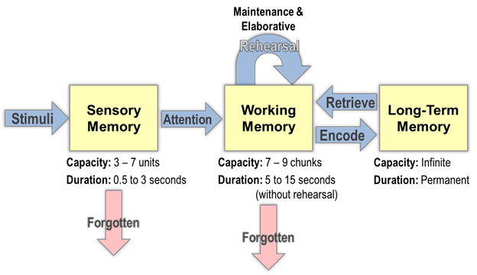
Multi-storage view of memory

Slide 8
A functional view of memory systems
Echoic Memory:
Feature extraction
STM:
<-> Interference of other traces
LTM:
explicit learning rehearsal
mnemonics
implicit learning (learning by exposure)
consolidation (hippocampus, sleep effect)
<-> Decay of traces
& perceptual binding
<-> fast decay
<-> Interference and Reconstruction
segmentation & chunking

Slide 9

Iconic memory
You just have to stare at the little plus sign in the middle for about a minute, and then quickly look at the white surface. The effect will be stronger if you blink your eyes repeatedly.

Slide 10
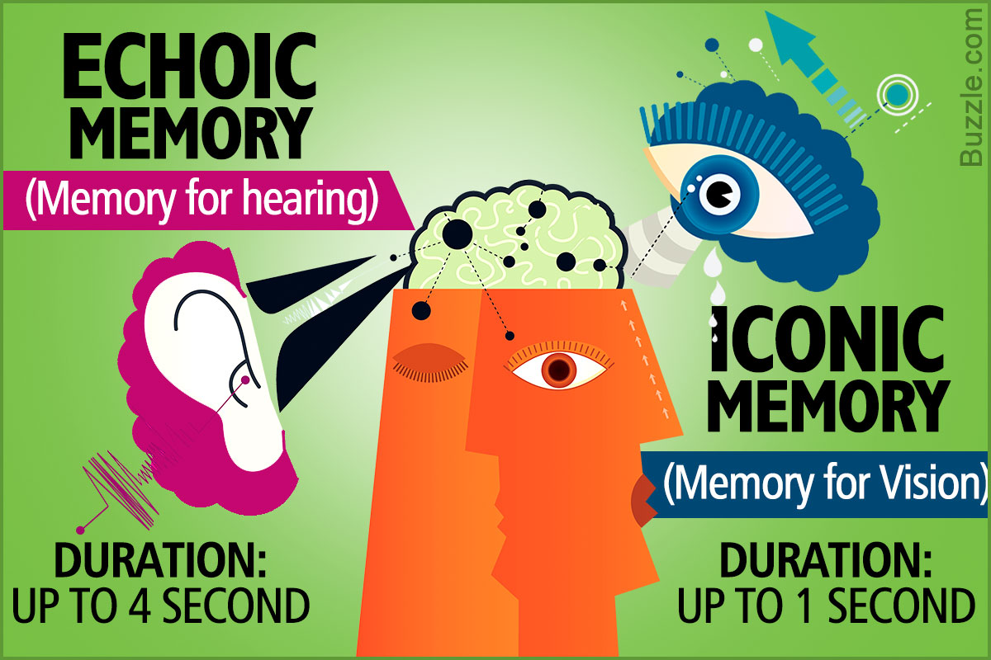
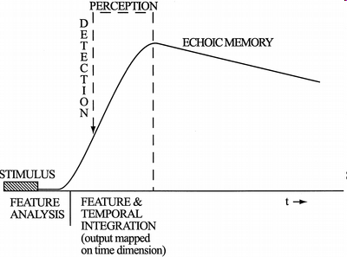
Echoic or Sensory Memory
Trace that stimuli leave just after the transduction
Probably it is accounted by the connections up to the thalamic centres
It accounts for the basic feature extraction (pitch, intensity, onset, noise, harmonic pattern, spatial position…)
Extracted features are “bounded” (what goes with what, e. g. a given partial with another one and with a fundamental coming all of them from the same direction)
Active up to 4 seconds, very fast degradation after 50ms
Sensory coding (no conceptual or categorical coding available)

Slide 11
Short-term Memory
Temporal storage for helping the permanent encoding (aka “Working Memory”)
Grounding of our sensation of “present”, a shifting focus of awareness selects what/how much is it processed
Has limitations: capacity (7+/-2 items) and time (around 10-20 seconds)
Chunking and rehearsal help to overcome these limitations
Has “sensory-specific” sub-blocks (for dealing with visual-spatial, phonological, pitch information –parallel processing of them)
Attentional mechanisms “modulate” what is stored in short-term and which type of processing is devoted to that

Slide 12
Operations in STM: Segmenting
The continuous musical texture is broken into shorter sequences using “segmentation cues”
⁻> “Closure” and “Change” detection
Pauses, silences, stretching of notes
Instrument changes
Cadences
Accents and other metrical elements
Tendency changes, contrasts (up-down melody, long-short notes, etc…)

Slide 13
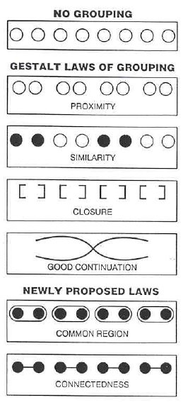
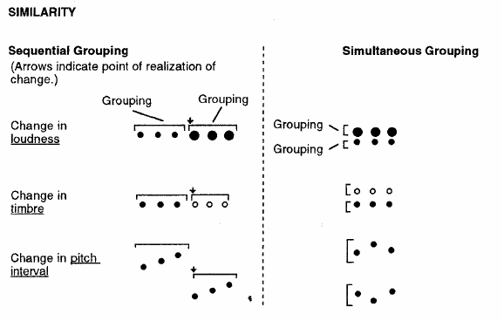
Operations in STM: Grouping

Slide 14
Operations in STM: Grouping
Lerdahl & Jackendoff “grouping well-formedness rules” and “grouping preference rules” (Generative Theory of Tonal Music)
Well-formedness rules define (abstract) structural descriptions that can be derived from the surface structure (a series of hypotheses for organizing the musical structure)
Grouping preference rules define the conditions that allow a listener to choose the preferred interpretation of the structure from all of the possible ones that conform to the well-formedness rules (connected to real perceptual events)

Slide 15
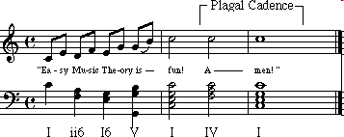
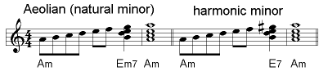
Operations in STM: Chunking
Encoding or consolidation of small groups of elements into a compact larger or more abstract element, which is then encoded, recognized or remembered
Example: Memorize this series of letters:
F-B-I-C-I-A-U-S-A-C-N-N-I-B-M
You create chunks of 3 letters that “go togheter” in an existing memory
Musical scales and chords can be used as elements that facilitate chunking (you usually do not code the individual notes)
C-E-G-B -> C major 7
Cadences
Similarity and relatedness between the sequential elements facilitates chunking; not only a “top-down” (knowledge-based) effect

Slide 16
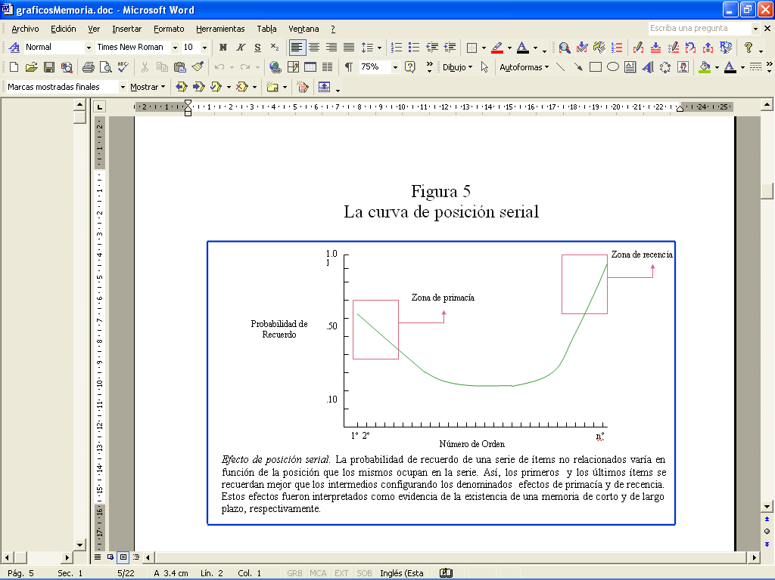
Serial position effect
Long-term memory effect, if you do not allow enough time to encode between each item, then the segment is flat
Recency
Primacy
Probability
of recall
Short-term memory effect, if you wait 30” for retrieving the items, the segment turns flat
Position

Slide 17
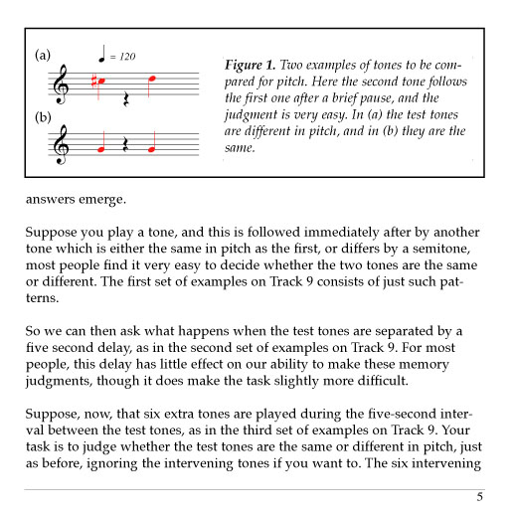
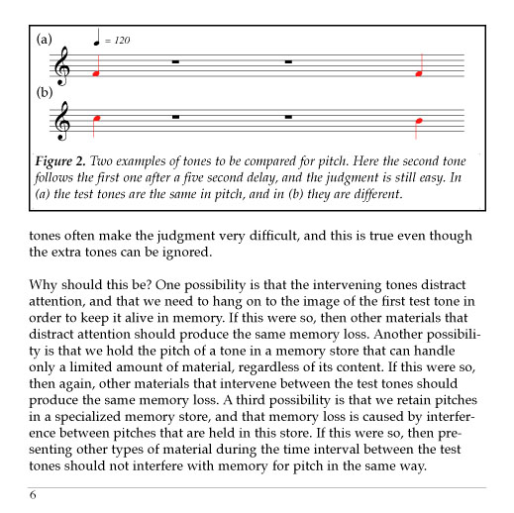
Pitch-specific short-term memory
Deutsch
experiments

Slide 18
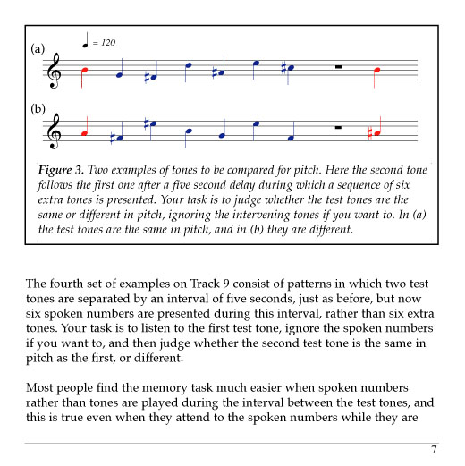
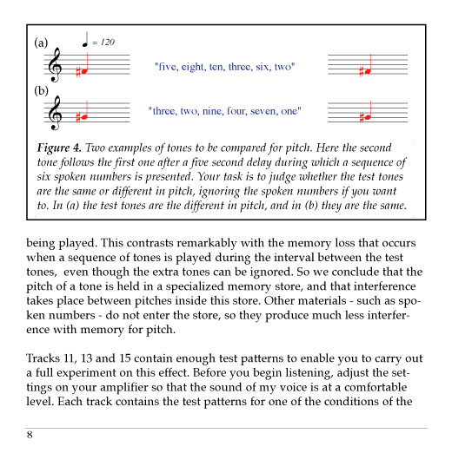
Pitch-specific short-term memory
In which condition should we expect more errors?
What if the
interference
was like
“A, B, D, F, A, C”
?
http://deutsch.ucsd.edu/psychology/pages.php?i=209

Slide 19
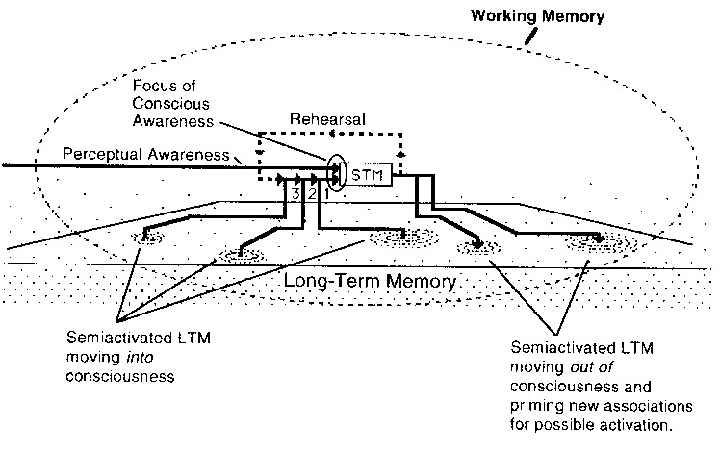
STM-LTM

Slide 20
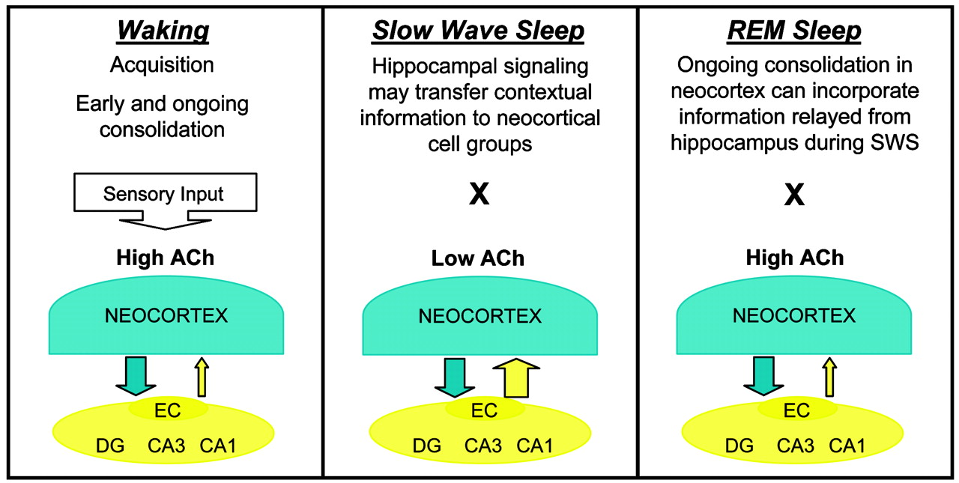
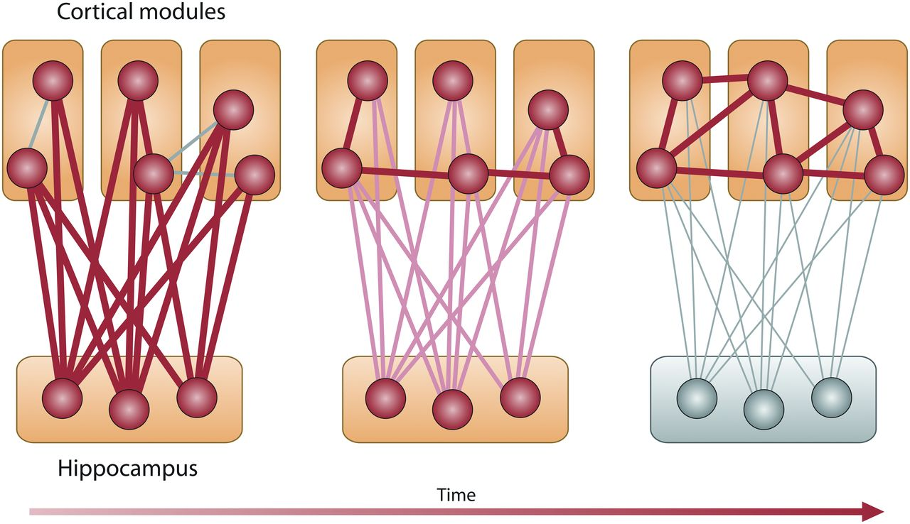
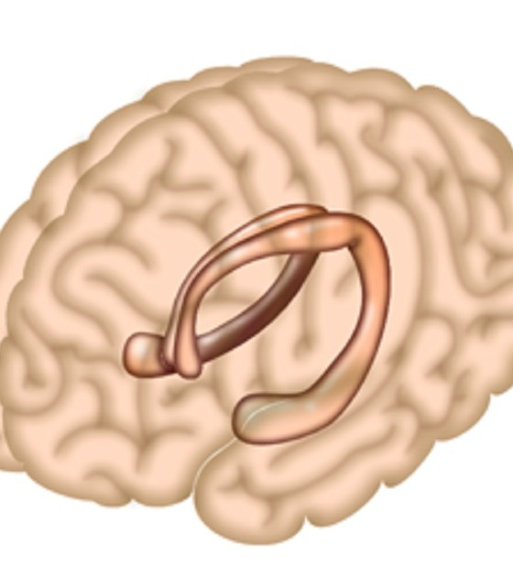
Memory consolidation

Slide 21
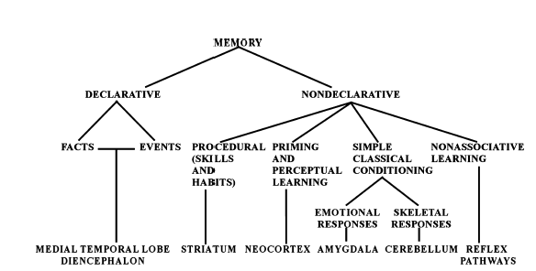
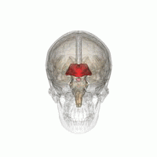
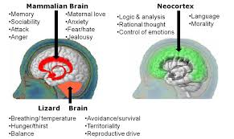
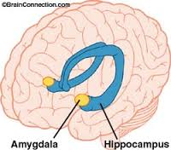
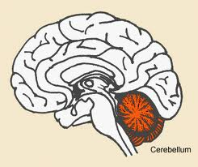
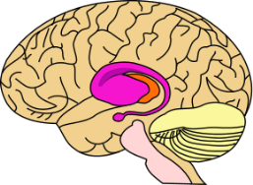
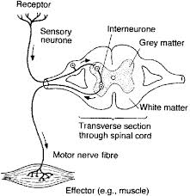
(Long-term) Memory systems of the brain (from Squire, 2004)

Slide 22
Declarative-Non Declarative Memories
Declarative (~ explicit memory):
Consciously available
Fast learning, even “single-trial”
Events (autobiographic memory) + Facts
Non-Declarative (~ implicit memory):
Contents consciously “unavailable” or interfering its development when trying to make them conscious
Slow learning
Automatic once learning has happened (“compiled knowledge”)
Often modality-specific

Slide 23
Declarative memory
What is this note name? What’s the name of the piece?
Episodic memory: memory for specific event in time (e.g. “that” performance of Don Giovanni that we saw in Vienna) ~ autobiographical memory
Semantic memory: memory about things of the world, common-sense (e.g., Don Giovanni is an Opera by Mozart)
Both are associative and distributed
Both are reconstructive (“extra info”, not encoded in the original event, can be generated at retrieval time)

Slide 24

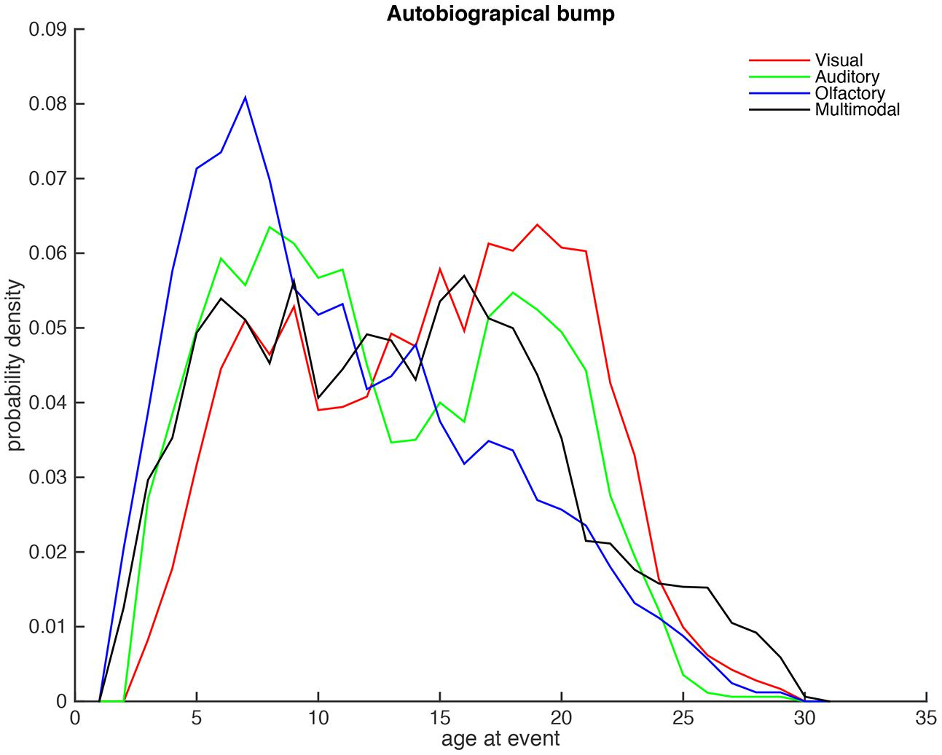
Autobiographical memories
Alive inside (Effect of music on Alzheimer’s patients:
https://www.youtube.com/watch?v=I7GF7_xyeH8

Slide 25
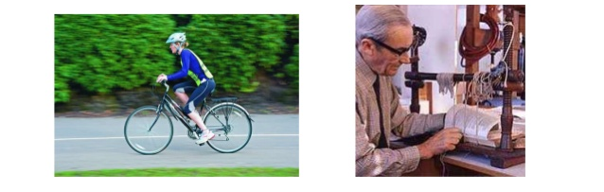
Non-declarative, Procedural memory
How does the melody go? How should I play this phrase with this instrument?
Procedural knowledge is slowly acquired, usually “by doing”, it is very long-lasting
Usually related to “sequences” of sensory/motor representations (e.g., finger movements, notes, etc.) -> Grammars (they define “correct sequences”)
Difficult to retrieve verbally, often causing interference
After some amount of practice knowledge is “compiled” into big chunks that are not accessible to introspection
how the chess expert knows the best movement? -> nothing to do with Deep Blue!!!

Slide 26
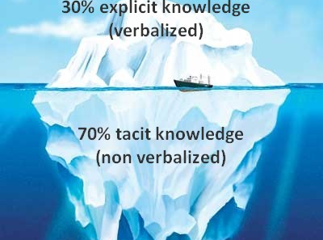
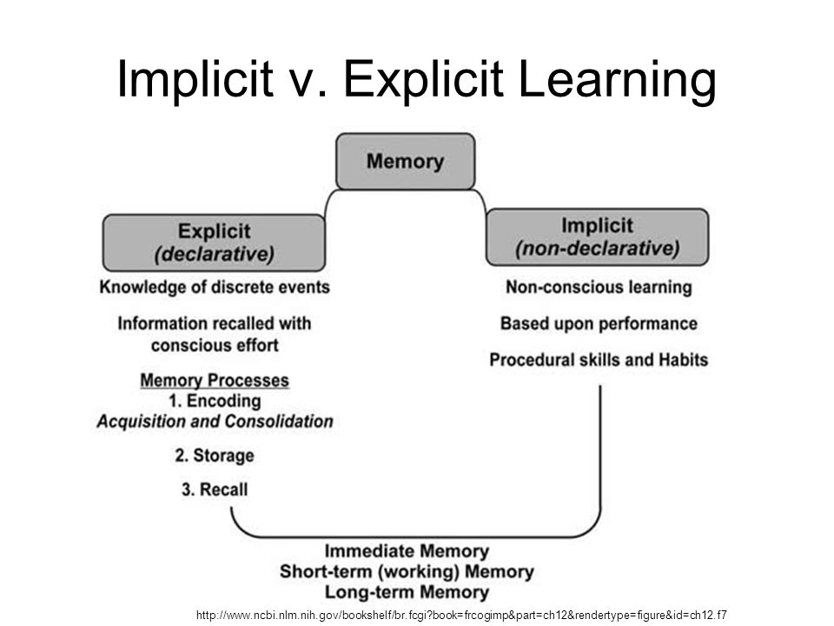
Implicit musical knowledge
Western listeners, even those without musical instruction, have extensive knowledge of typical tonal and harmonic patterns (and melodic, rhythmic and metric patterns too!): tonal hierarchies (i.e., “key”)
Statistical regularities are extracted from musical input by the learning brain provided proper and frequent exposure (the cues for the tonal hierarchy (the key) are present in the surface details of a melody – duration and frequency of occurrence of pitches-)
Knowledgeable listeners, even from another culture, can pick up on those cues, provided a certain amount of exposure

Slide 27
Types of retrieval
Retrieval operations
Recognition: acknowledgement that a pattern in STM is stored in LTM (did you hear this song before? Does it sound familiar?) Recognition may happen without further recall or reminding
Recall or Recollection: activation of a LTM encoded pattern by a “diffuse” effort of will (what is the title of this song? Who was the composer?)
Reminding: activation of a LTM encoded pattern by a pattern in STM (which memories are activated by listening to this song?)
Decoding
depth

Slide 28
Phrasing The way notes are joined/separated/played into a meaningful “unit”, which separates from the previous one and from the next one A musical resource to help segmentation in short-term memory
Ecole Notre-Dame: Messe du Jour de Noël (Ensemble Organum), Evangelie-Prologue de St Jean:
https://youtu.be/lZE5jeOpIoM?t=1431
Yo-Yo Ma - Bach: Cello Suite No. 1 in G Major, Prélude: https://www.youtube.com/watch?v=1prweT95Mo0
Philip Glass - Music In Fifths: https://youtu.be/vzRHX4cjOhI?t=2013
Max Roach & Booker Little - 1961 - Percussion Bitter Sweet - 01 Garvey's Ghost: https://www.youtube.com/watch?v=-WJ0GqWHhII
Sokkan (Breath-Sight) - Riley Lee on 3.6 shakuhachi: https://www.youtube.com/watch?v=JvReK4-WI1Y

Slide 29
Themes, variations and motives Musical strategies to increase the memorability and association of musical materials
/
Music Theory Lesson - Theme and Variations: https://www.youtube.com/watch?v=raqOYw5kRdc&list=PLuCL1S44G_w9QKhJjblHe6mV301b60l4I
Theme vs. Leitmotif:
https://www.youtube.com/watch?v=qVlsIhbQ2qM
Wagner's Ring Cycle Leitmotifs:
https://www.youtube.com/watch?v=wvA54D2Gz3E
Mozart twinkle twinkle little star 12 variations piano:
https://www.youtube.com/watch?v=9bK9h12Qdvs
Harry Potter Theme and Variations:
https://www.youtube.com/watch?v=N2yrptmBem8
The Lord of the Rings’ Themes:
https://www.youtube.com/watch?v=LApVgSRXzSY&t=26s
Lord Of The Rings: How Music Elevates Story
https://www.youtube.com/watch?v=e7BkmF8CJpQ&t=45s

Slide 30
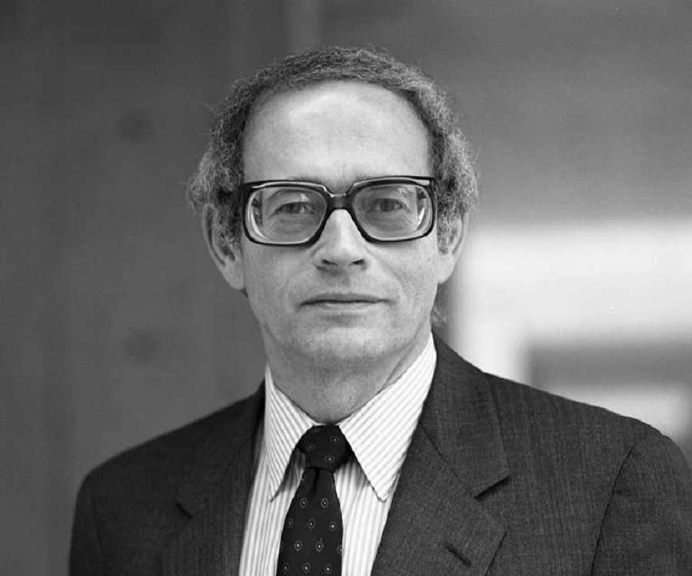
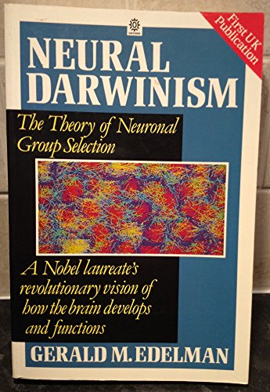
“The problem of perception is initially a problem of taxonomy in which the individual animal must “classify” the things of its world (…) The internal taxonomy of perception is adaptive but is not necessarily veridical in the sense that it is concordant with the descriptions of physics”
Edelman, Neural Darwinism, p. 26

Slide 31
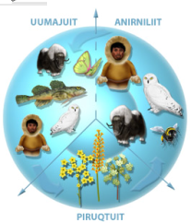
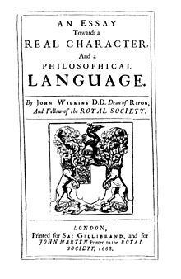
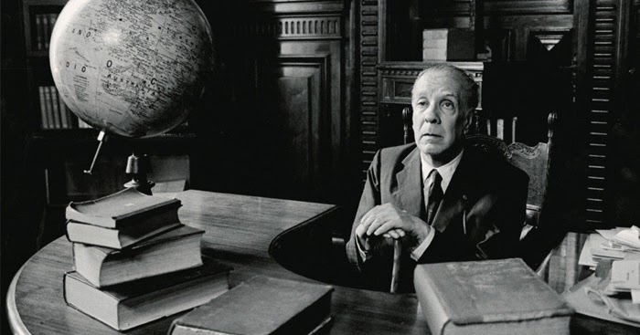
The animals are divided into: (a) belonging to the emperor, (b) embalmed, (c) tame, (d) sucking pigs, (e) sirens, (f) fabulous, (g) stray dogs, (h) included in the present classification, (i) frenzied, (j) innumerable, (k) drawn with a very fine camelhair brush, (l) et cetera, (m) having just broken the water pitcher, (n) that from along way off look like flies. Jorge Luis Borges,
The analytical language of John Wilkins

Slide 32
What happens with this music?
La Monte Young:
The Four Dreams Of China
https://www.youtube.com/watch?v=xFooQfI7dgA
1
Pierre Boulez :
Le Marteau sans maître
https://youtu.be/WpqYo5u3wII?t=2084
2
Pierre Boulez:
12 Notations pour piano w/ score
https://www.youtube.com/watch?v=cD2SwVZBI80
3
Morton Feldman:
For Samuel Beckett
https://www.youtube.com/watch?v=olp3IzR-R6g
4
King Übü Örchestrü:
Translation #1
https://destination-out.bandcamp.com/album/binaurality
5

